Slide 1
Advanced C++

Slide 2
What is C++ and Purpose?
The prime purpose of C++ programming was to add object orientation to the C programming language, which is in itself one of the most powerful programming languages.

Slide 3
There are a few principle concepts that form the foundation of object-oriented programming:
Class
Object
Abstraction
Encapsulation
Inheritance
Polymorphism

Slide 4
Object :-
This is the basic unit of object oriented programming.
That is both data and function that operate on data are bundled as a unit called as object.
It is an instance of Class

Slide 5
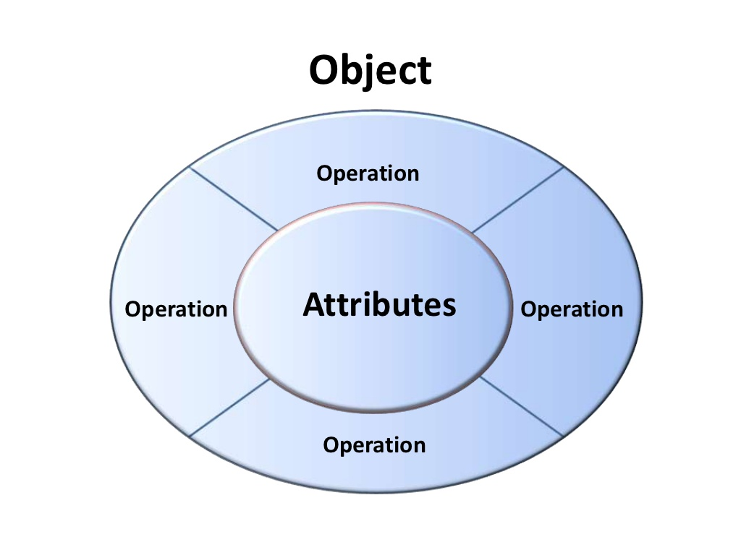

Slide 6
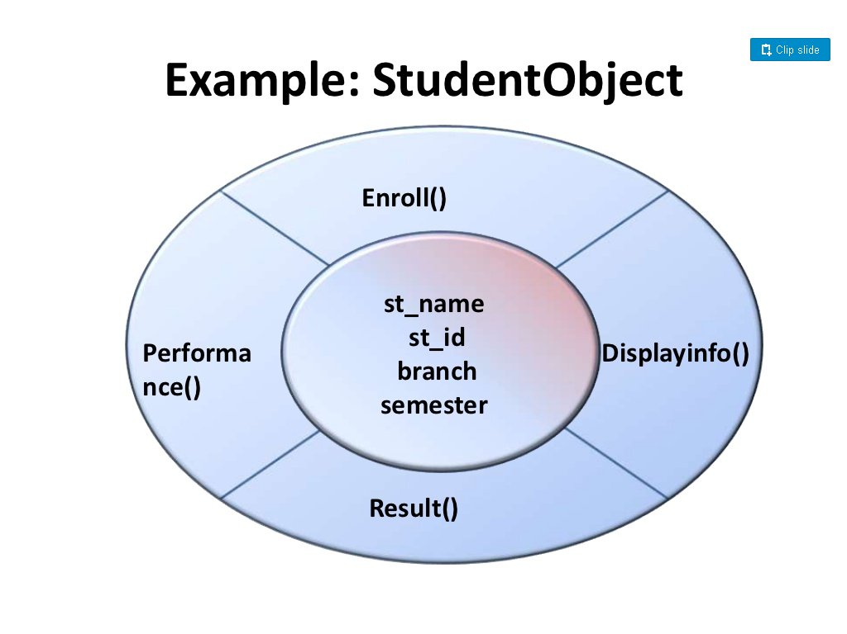

Slide 7
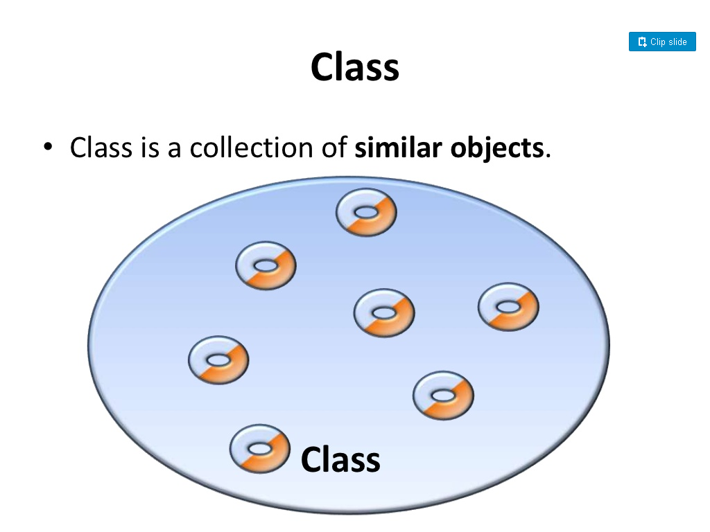

Slide 8
When you define a class, you define a blueprint for an object.
This doesn't actually define any data, but it does define what the class name means, that is, what an object of the class will consist of and what operations can be performed on such an object.

Slide 9
Abstraction
Data abstraction refers to, providing only essential information to the outside world and hiding their background details, i.e., to represent the needed information in program without presenting the details.
For example, C++ classes provides different methods to the outside world without giving internal detail about those methods and data.

Slide 10
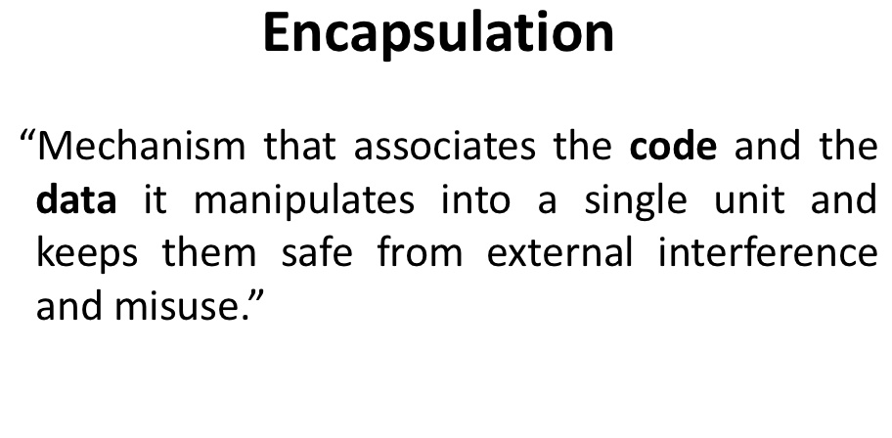

Slide 11
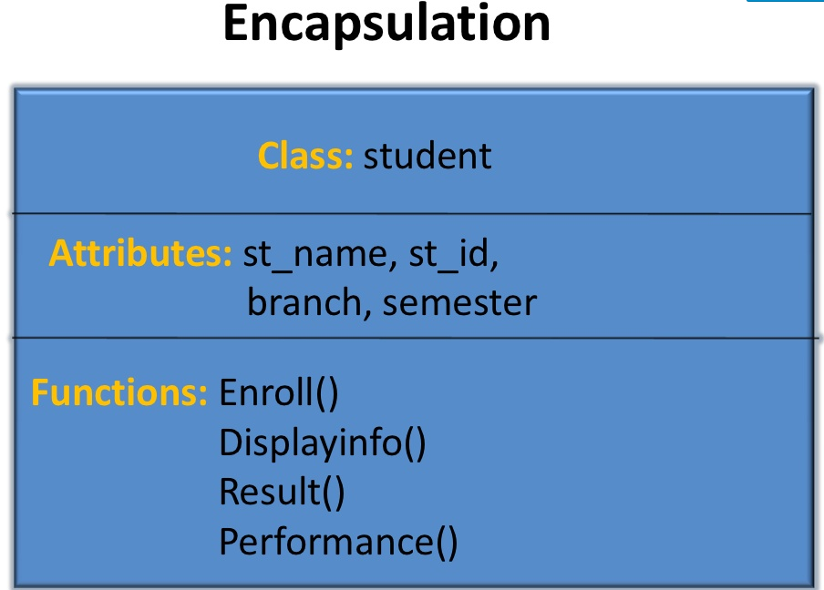

Slide 12
Inheritance
One of the most useful aspects of object-oriented programming is code reusability.
Inheritance is the process of forming a new class from an existing class that is from the existing class called as base class, new class is formed called as derived class.

Slide 13
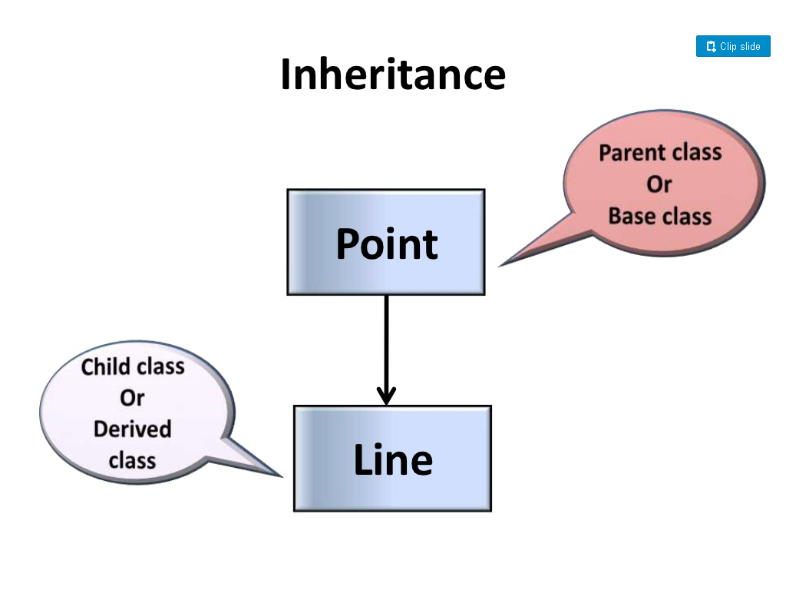

Slide 14
Polymorphism
Poly refers to many and morphism means forms.
Overloading is the concept of Polymorphism.

Slide 15
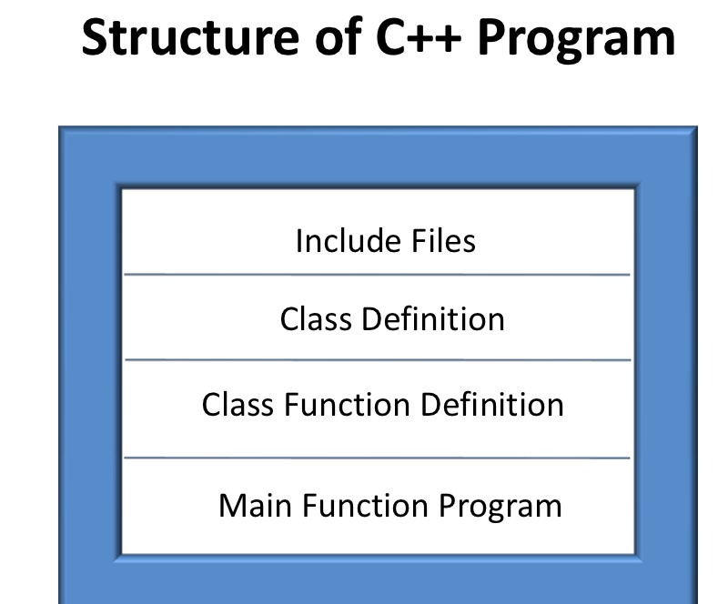

Slide 16
